Slide 1


SOLELY FOR PURPOSES OF FORAGE WORK EXPERIENCE
BRITISH AIRWAYS
Customer ratings analysis and insights
25-03-2025

Slide 2
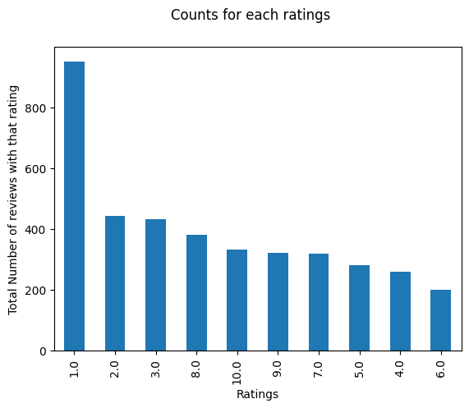
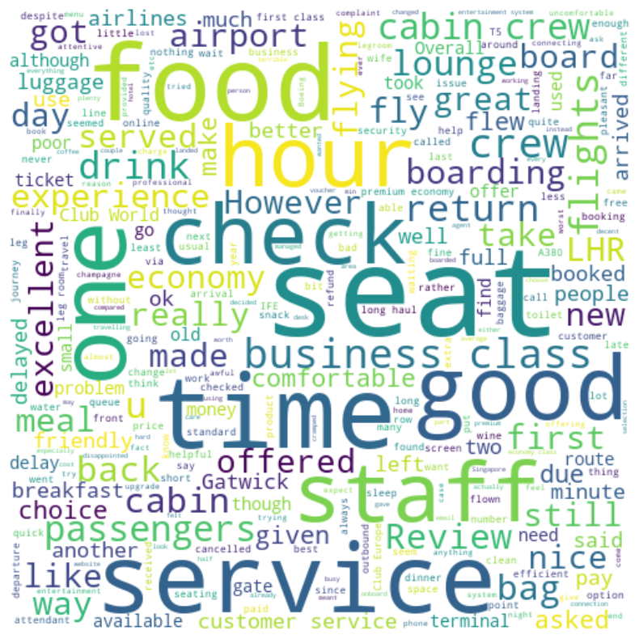
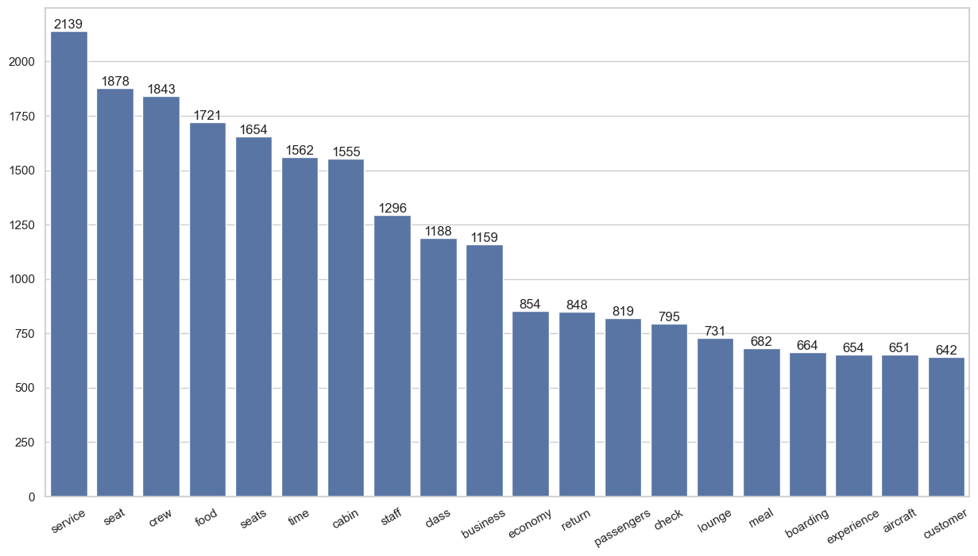
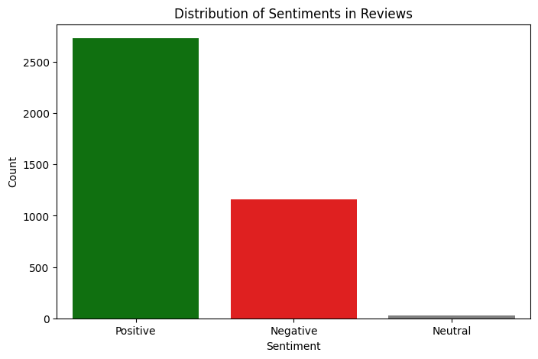
Average Overall Rating
4.66 /10
3924 Total reviews
collected
Sentiment Distribution:
Customer sentiment is predominantly positive, though a notable portion of reviews express neutral or negative feedback.
This indicates generally satisfactory service but highlights specific areas needing attention to improve consistency.
The analysis of airline reviews from Skytrax reveals key customer sentiment trends, with frequent mentions of "service," "seat," and "crew" indicating priority areas for improvement.
Sentiment analysis and word frequency visualizations highlight operational strengths and weaknesses, providing actionable insights for enhancing passenger experience.
Rating Distribution:
Most reviews cluster in the mid-range (6–8/10), suggesting passengers find the experience acceptable but not outstanding. Fewer extreme low or high ratings point to a lack of strong polarizing experiences.
Recommended Actions:
Focus on improving seat quality and boarding efficiency to reduce common complaints.
Highlight crew performance in branding to reinforce strengths.
.

